Slide 1
75th Anniversary
May 31st, 2024

Slide 5
Photo Credit: Dave Anderson

Slide 6
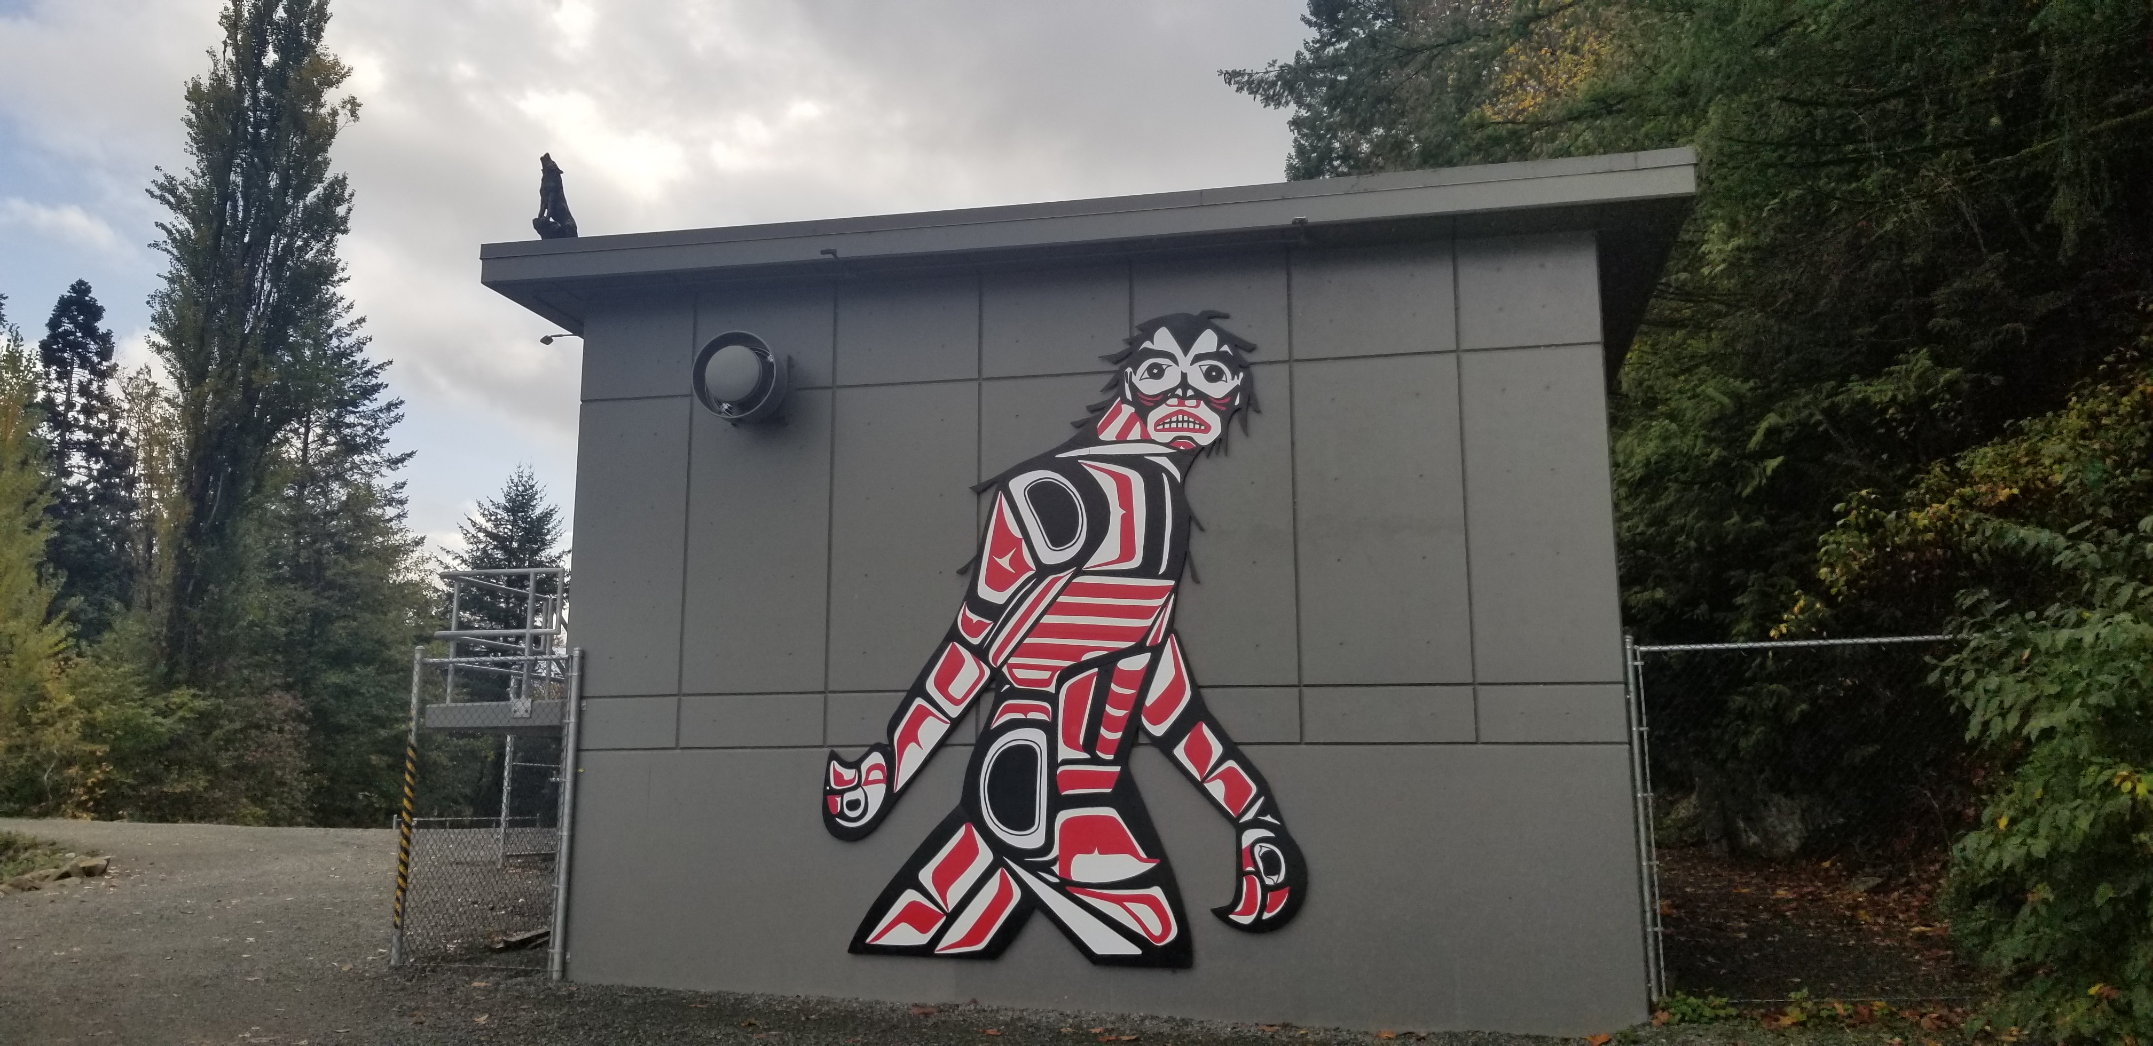

Slide 7
Photo Credit: Kelli Easton

Slide 8
Photo Credit: Kelli Easton

Slide 9
Photo Credit: Kelli Easton

Slide 11
Photo Credit: Kelli Easton

Slide 12
Photo Credit: Kelli Easton

Slide 13
Photo Credit: Kelli Easton

Slide 14
Photo Credit: Kelli Easton

Slide 15
Photo Credit: Kelli Easton

Slide 16
Photo Credit: Kelli Easton

Slide 17
Photo Credit: Dave Anderson

Slide 18
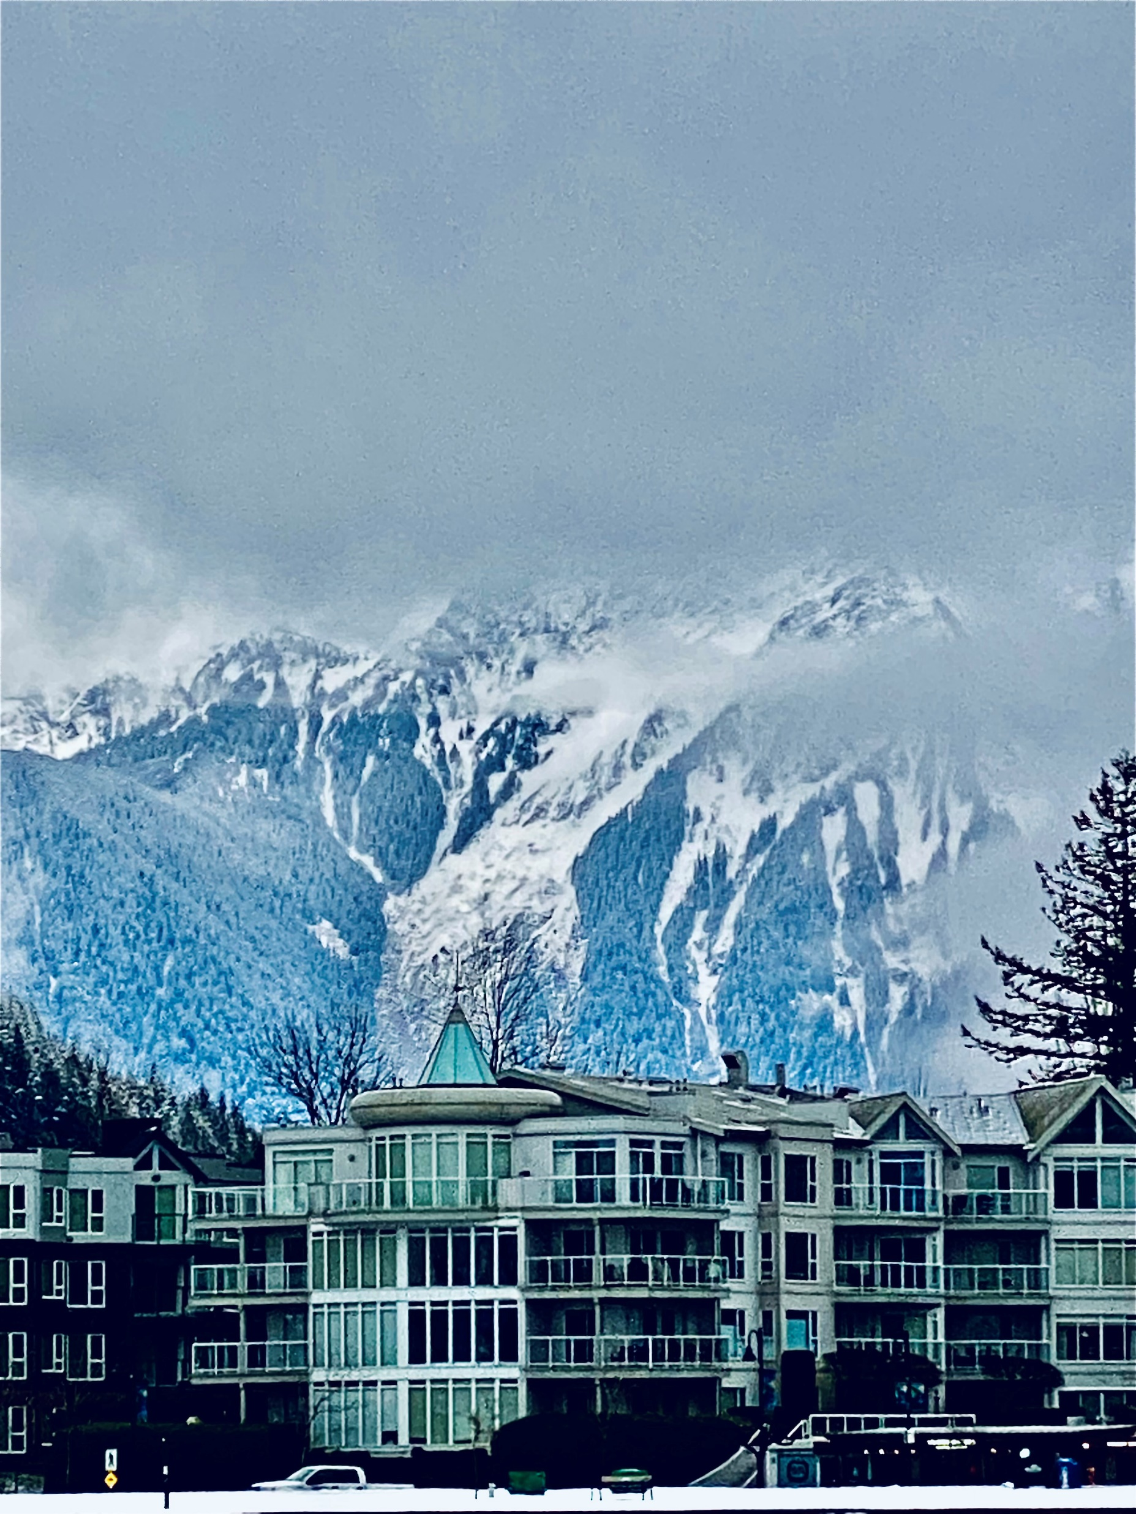
Photo Credit: Kelli Easton

Slide 19
Photo Credit: Kelli Easton

Slide 25
Photo Credit: Dave Anderson

Slide 26
Photo Credit: Kelli Easton

Slide 27
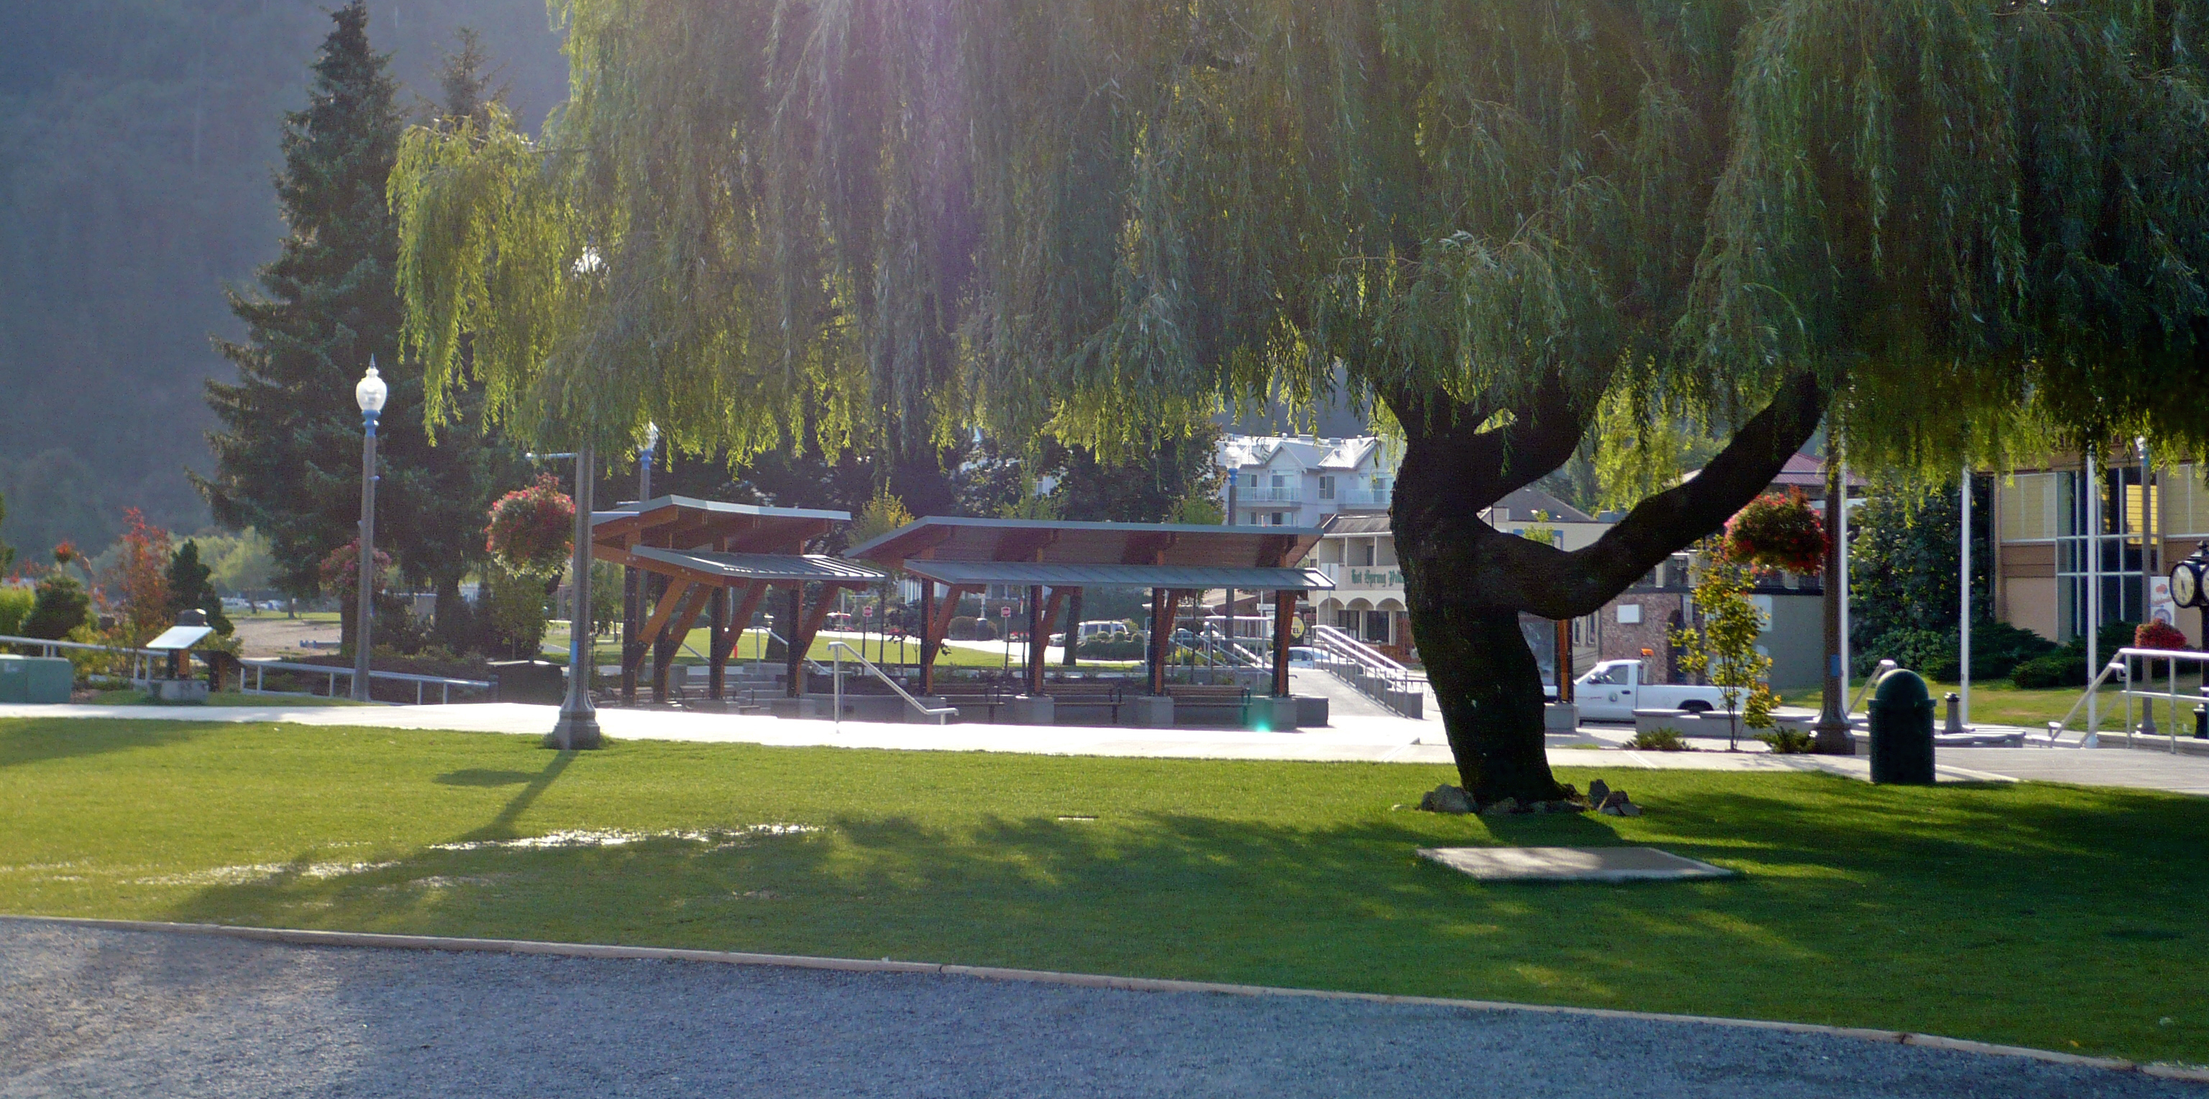

Slide 29
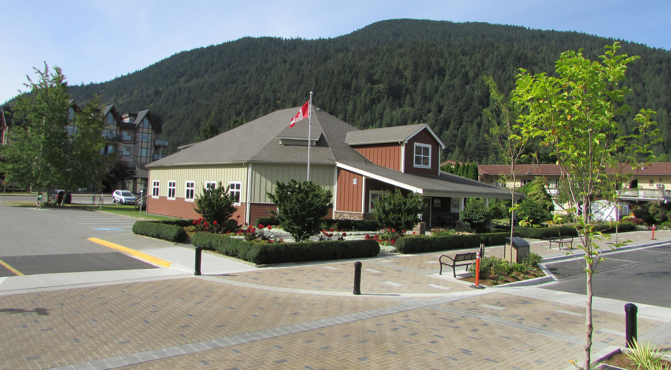

Slide 32
Photo Credit: Dave Anderson

Slide 33
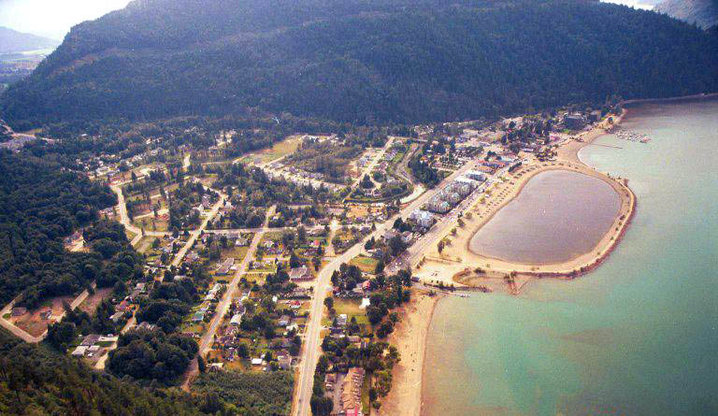

Slide 38
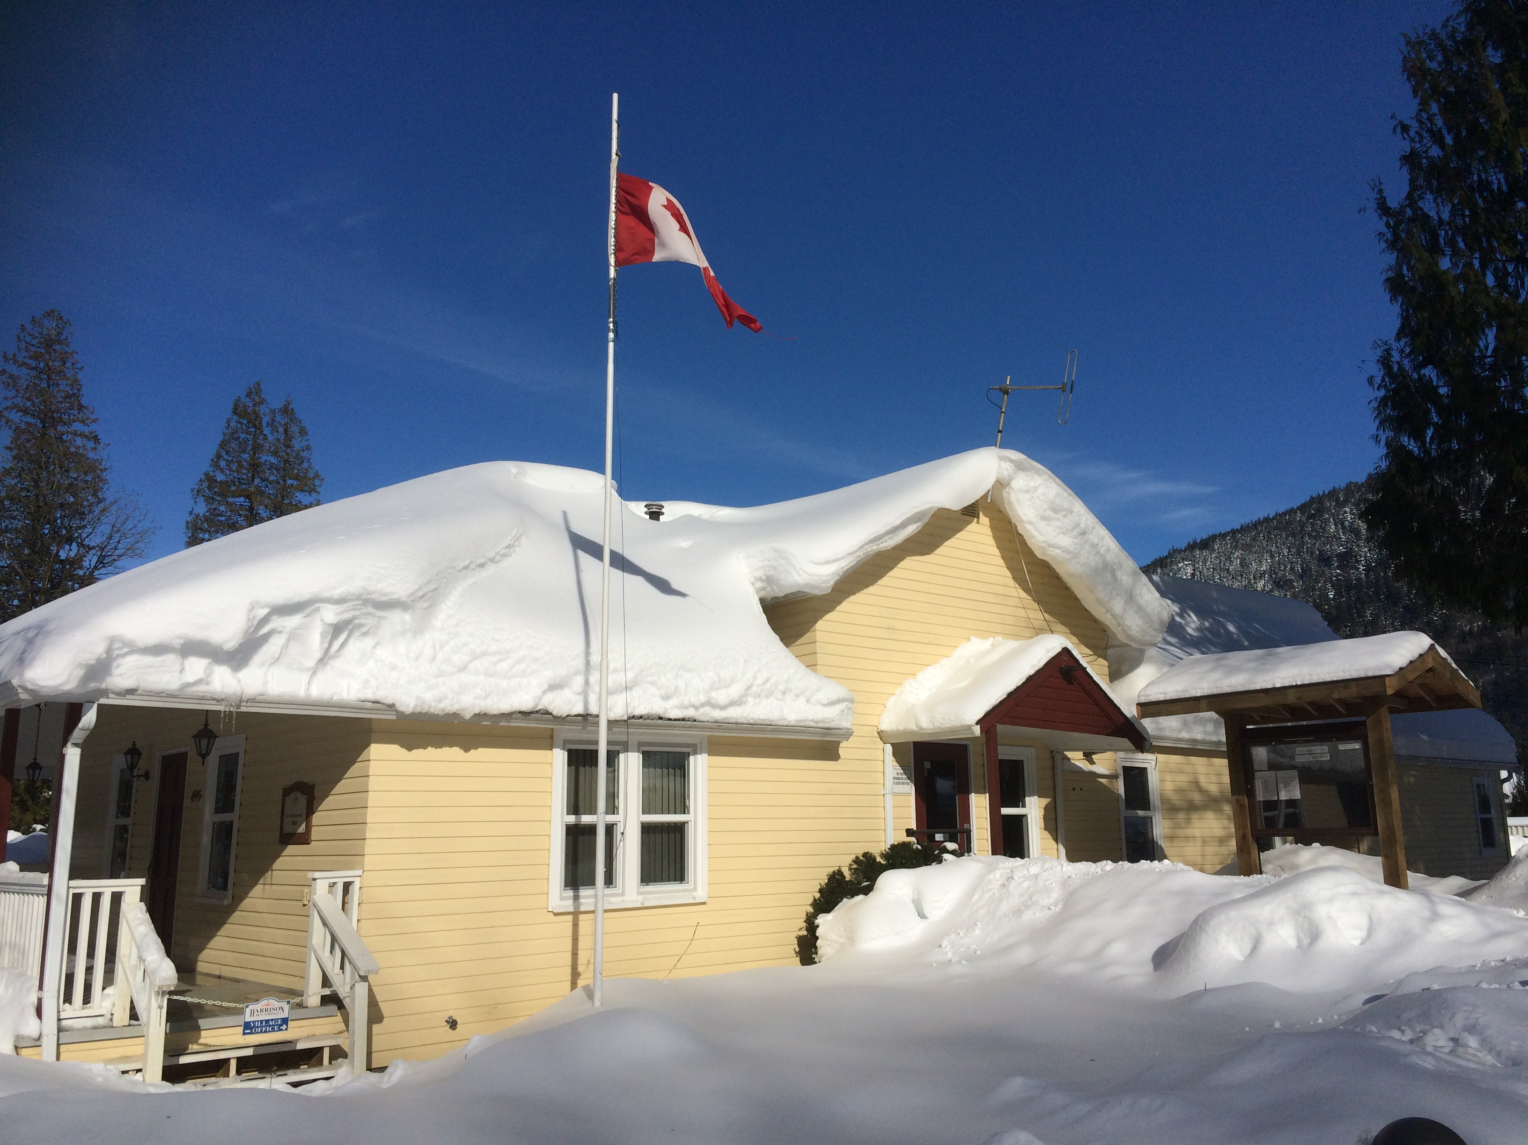

Slide 41
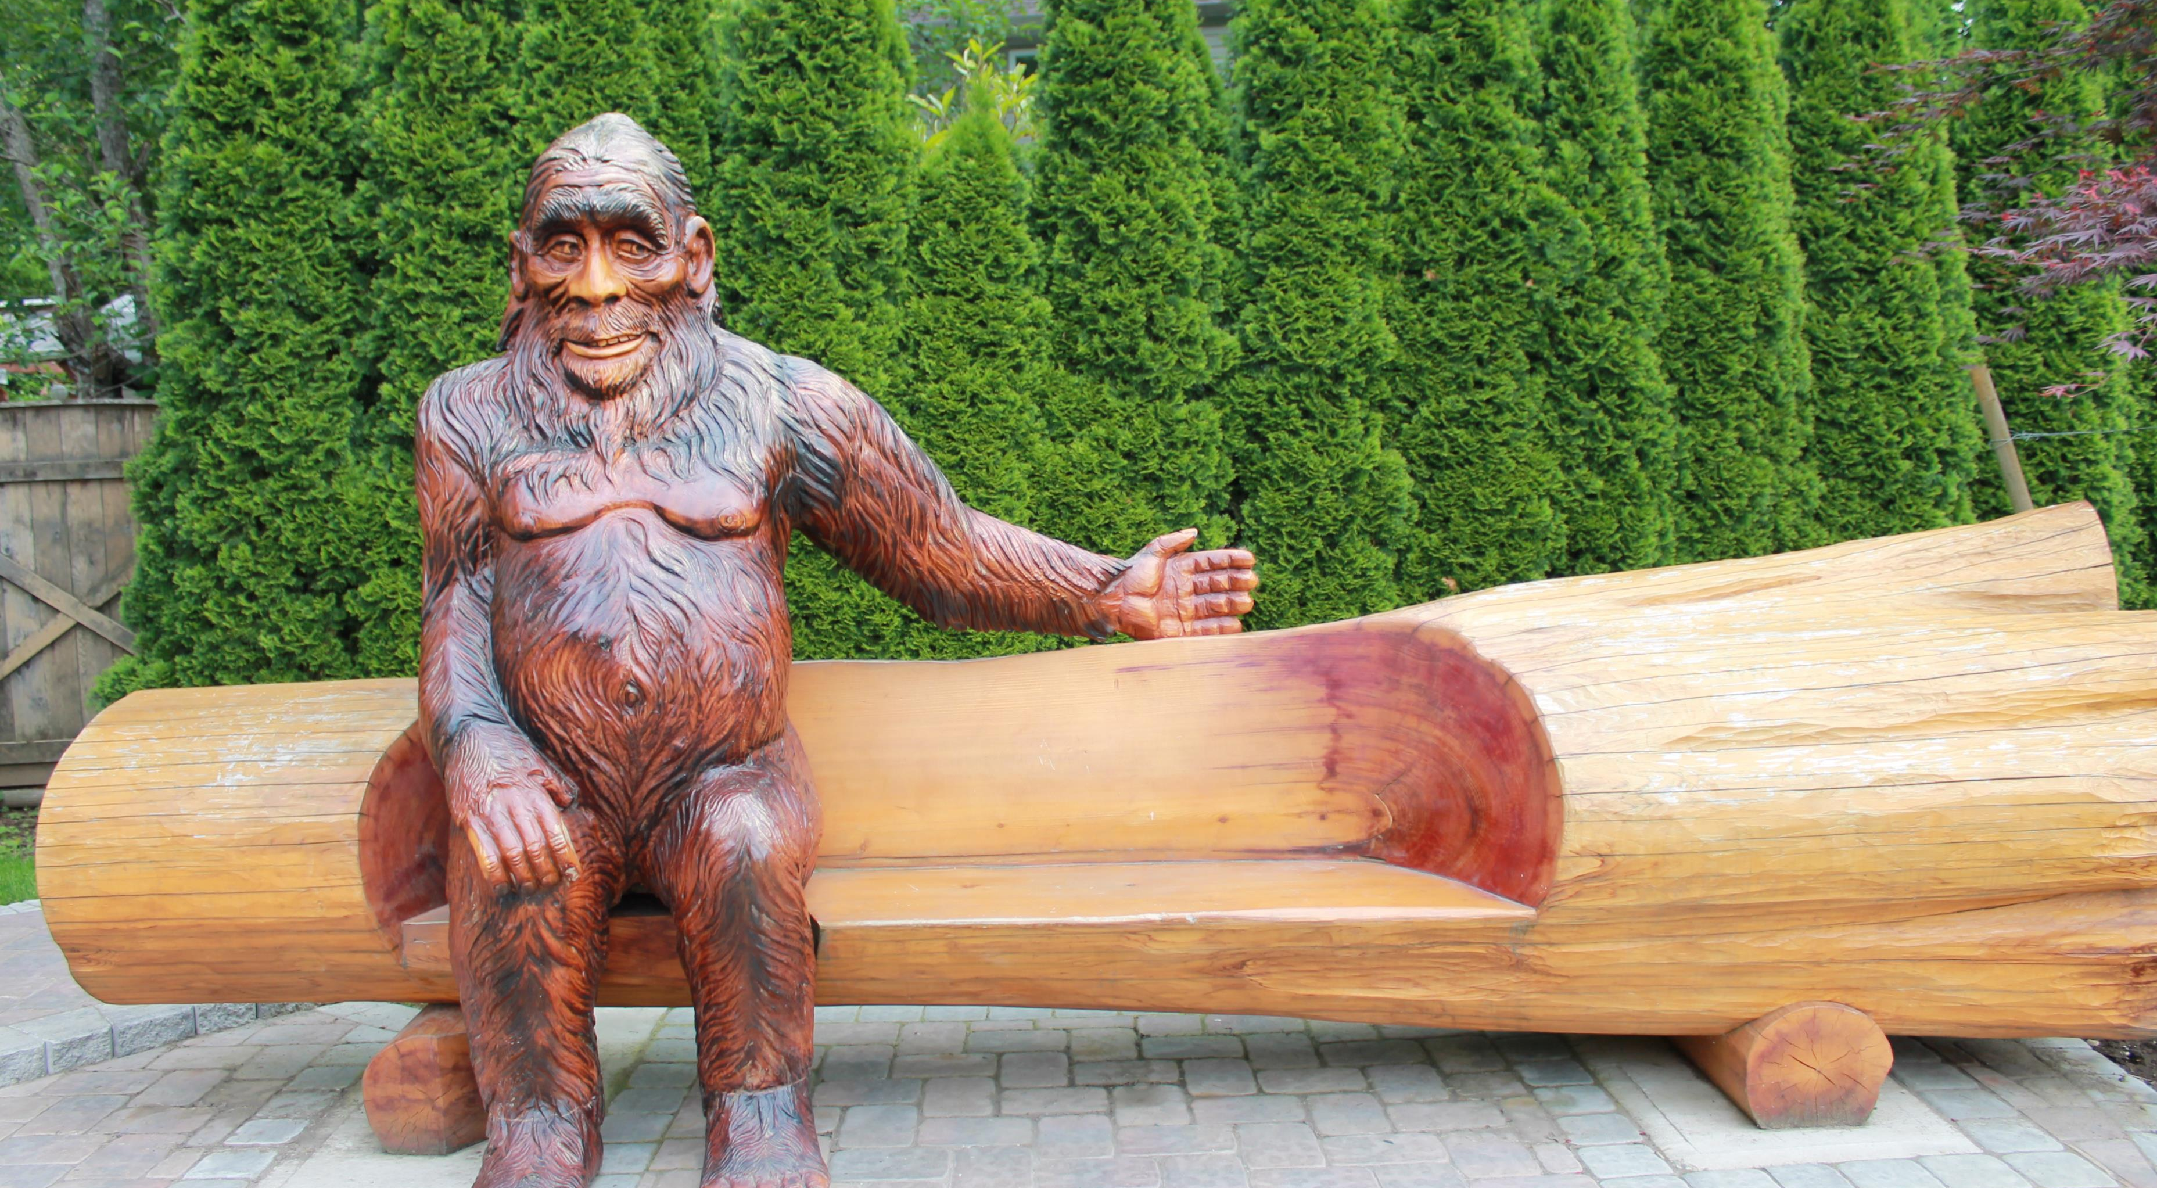

Slide 42
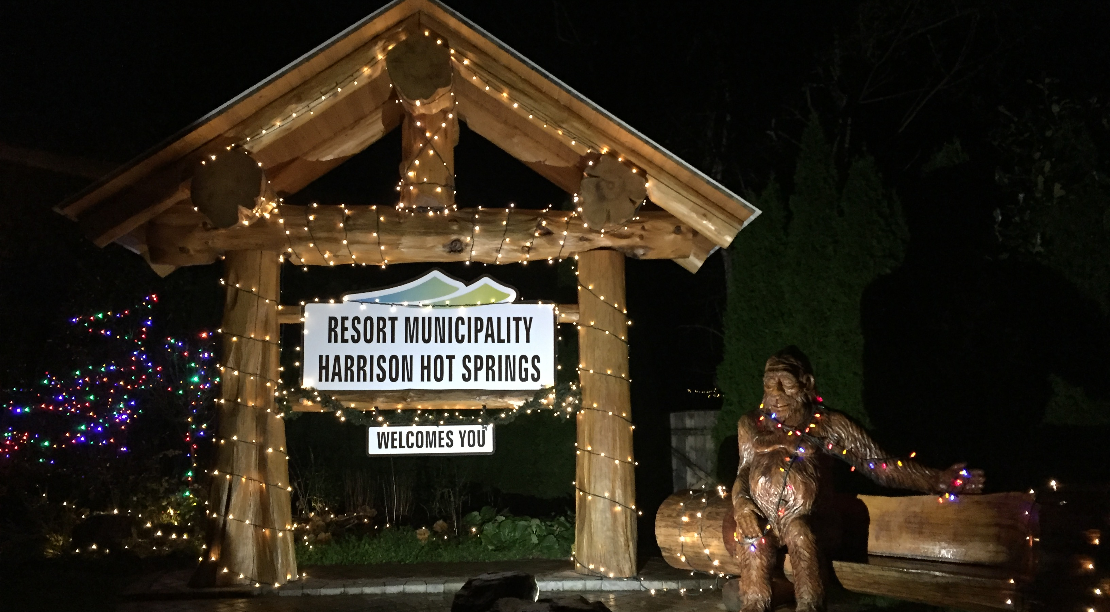

Slide 43
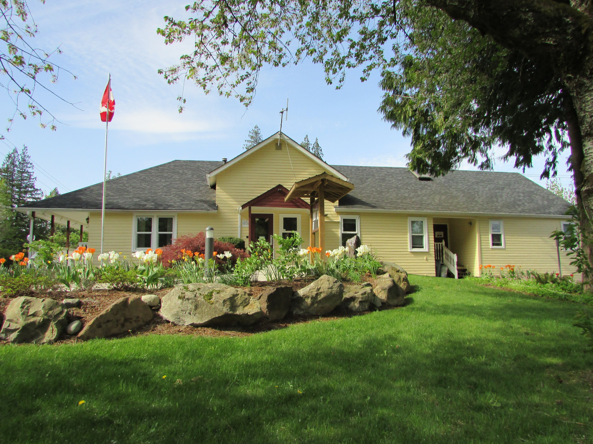

Slide 44
